Slide 1
Let’s make TPR one of your superpowers!
Lee Salkowitz
OCSA - COACH Kickoff 2018

Slide 2
Objectives
Objectives
Objectives
After this hour, I hope that you
Understand the benefits and challenges of the TPR approach
Have a day 1 ready script
Feel like you have a new superpower at your fingertips

Slide 3
A letter from Dr. James Asher
Please visit -
www.tpr-world.com

Slide 4
TPR Prior Knowledge...Where are you?
I know I have I feel I want

Slide 5
Let’s play!
If I read a statement that pertains to you please stand and say “That’s me!”
Remain standing until you hear something else that pertains to you and then sit down and say “That’s me!”
Is TPR your superpower or is it your kryptonite?

Slide 6
Why I love TPR in all levels!
It’s low stress for students and a great brain break
Long term memory retention and is right brain friendly
It’s great for kids and adults
TPR is a tool in our tool box
Enjoyable for teachers … or is it?

Slide 7
Why TPR can be my kryptonite...
It makes me crazy - to script or not to script?
Sometimes I feel like a terrible teacher
I underestimate the planning involved
It takes a lot of practice to get good at

Slide 8
Pick your words wisely
Notes:
In a typical TPR lesson you input more than in a TPRS lesson

Slide 9
Try using words that are concrete
Carries
Jumps
Sleeps
Points at
Honks
Kisses

Slide 10
Your super power
Model Mistake Delay Remove
Simon Says
Hardest

Slide 11
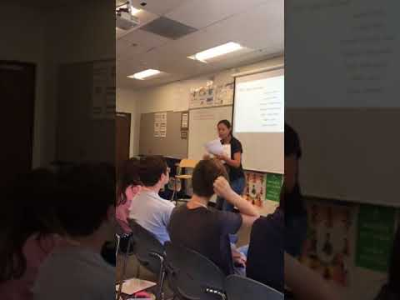
Sounds easy right?

Slide 12
What the experts say.
Establish meaning with gestures
Begin with single commands
Move to chain commands
Alternate between both
Use groups

Slide 13
Please draw your classroom or your imaginary classroom

Slide 14
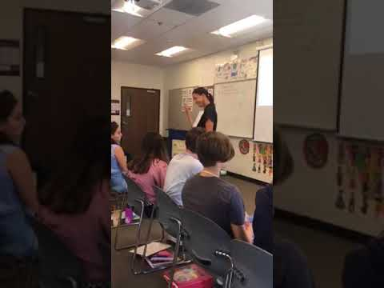
Now group your students
By countries
By grade levels
By seat numbers
By cities
Really by anything

Slide 15
Picking your words to TPR
Backwards plan them from a goal
Use highly frequent words
Backwards plan from a reading
Have a go to for brain breaks

Slide 16
Remember to use single and chain commands
combined with
Individual and group sequences

Slide 17
Story telling opportunities and tough groups
The possibilities with TPR are really broad
Often times the reluctant student doesn’t understand
If they do understand, give them a prop so they take being “too cool” to being important
When you begin to ask more questions, you being to personalize and you begin to form a story

Slide 18
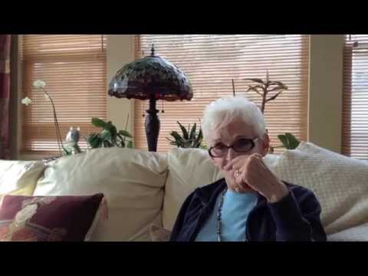
Our local expert...the one and only - Berty Segal

Slide 19
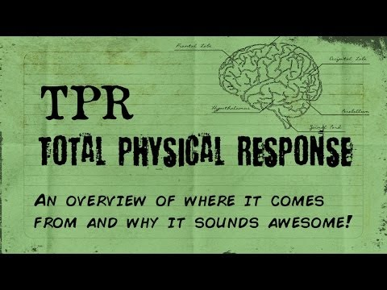
Some theory on TPR - really interesting stuff!

Slide 20
Thank you for coming to my breakout.
Did we do what we said we would?
Do you?
Understand the benefits and challenges of the TPR approach?
Have a day 1 ready script?
Feel like you have a new superpower at your fingertips?

