Slide 1
New Teacher
Panel
Tips and Tricks

Slide 2
Nicole Beauchamp

Slide 3
Learn students’ names and do it fast. Make sure you can pronounce it correctly.
Ask students what they (think) they need. They have a better idea of their limits than you do. Just ask!
Be as honest as possible. If students trust you, they will help make your life easier.
Students care about how you make them feel. What they are learning comes after.
Notes:
Name tags that you collect back every day
Sometimes they misunderstand what they need, but as an adult it can help you figure it out. “A complaint is an unspoken request” - find out what it is and if you can reasonably meet it
Just tell them you are trying something new, they’ll be much more forgiving
If you didn’t care, you wouldn’t be here: show them that.
Keep snacks, a blanket, stuffed animals, hot chocolate, etc. whatever they need
Sometimes being strict is how you show them you care. Sometimes it’s letting them have an extra day to turn in an assignment. Know your students. (see #1)

Slide 4
Plan the big picture, take it piece by piece. As soon as you step in front of students, know that your plans might have to change! Do what you can with what you have.
Don’t bite off more than you can chew. When you work until you drop, you and your students suffer.
Find an organizational system and stick with it. A sub-optimal system is much, much better than none at all.

Slide 5
Gayle Trager

Slide 6
“Nothing Motivates Like Success”
by Susan Gross

Slide 7
Success in the Classroom
CI or TPRS gives students a chance to demonstrate success everyday
Students become excited and more confident to speak the target language in class
Students respond to compliments that are sincere and honest and specific

Slide 8
Explain to students how to be successful in your class.
What does “Paying attention” mean in language class?
How do you work with a partner successfully?
How do you earn participation points?
www.susangrosstprs.com

Slide 9
Assess less - “Jason Fritze “ Use more informal assessments and less formal tests and quizzes
Exit slips as a quick informal assessment at the end of class
Conversation carrousel or line ups for oral assessments
Practice and model timed writing in class before giving written assessments
Short unannounced quizzes to test what the students have acquired in class
Teachforjune.com , a website by Scott Benedict with great assessment ideas.

Slide 10
Griselda
Garcia Estrada

Slide 11
Support Group
Someone to talk to
There are days when just talking to someone makes your day better
Someone to plan with
New ideas
Looking at the same content with different eyes
Lifelong friends
Being a teacher is something unique.

Slide 12
Get out of your comfort zone
Build Relationships
Try new things
Just as you ask your students to be open and try, do the same.
Get to know your students
As students and as the person they are

Slide 13
Shari Kaulig

Slide 14
Backward Planning
Why are you teaching this? What do you expect students to do with language?
How will you assess learning? If you are teaching communicatively, your assessment should reflect that. Assess language in context.
What do students need to learn to be able to accomplish your goals for them?

Slide 15
Backwards Planning
Design the activities students will do that support learning.
Include reading, listening, speaking, writing
Personalization keep students engaged
Include movement activities
Vary grouping
How are you addressing culture?
Provide LOTS of Comprehensible Input!

Slide 16
Alma Vargas

Slide 17
Professional Growth
Observe other teachers
You can always learn a few tricks from other teachers.
Professional Development
As a teacher, we are constantly learning and there are always new ideas that we can bring into our classrooms.
Don’t compare yourself to other teachers
As long as you are growing, that’s all it matters.

Slide 18
Collaborate
Collaboration is a great way to grow and learn from others!
Engagement
Brain Breaks/Fun Friday
Students need breaks to be engaged.

Slide 19
Tina Livingstone

Slide 20
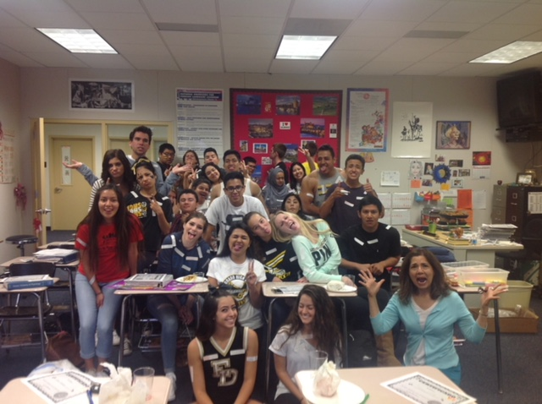
Back to School Night
Take pictures of your classes
Show class pictures as parents walk in
Write class, period and number of students.
Spanish AP
Period 2
36 Students
Profesora Livingstone

Slide 21
Back to School Night
Ideas for Back to School Night
Type up and pass out all the information that parents need to know for your class.
Have students teach their parents something they are learning in class.
Give participation points to parents for participating at BTSN
Play a game that you would do in class.
Teach a song to your parents.
Have fun with your parents

Slide 22
Thank you!
¡Gracias!
Merci!
Questions?
Contact information
is in the packet

