Slide 1
CI in the elementary classroom

Slide 2
How and why do you teach with Comprehensible Input?
Explain why you are teaching with Comprehensible Input.
Show them what teaching with Comprehensible Input is.
For little ones, explaining rules and expectations in Engish on the first day is okay.
On day one, you are trying to get students to buy into this as well as creating classroom culture.
On day two, you are creating culture and setting the mood for the rest of the year.

Slide 3
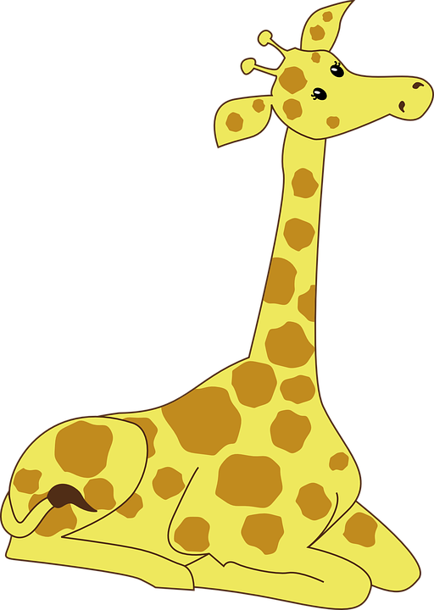
Build a mascot

Slide 4
WHy build a mascot?
Learn about your students and the classroom personality
Create a classroom community / identity
Include students in the creating process right away

Slide 5
Day 1 - 3 TPR/PQA/CIrcle VOcab
chico/chica
alto
bajo
fuerte
inteligente
le gusta
tiene
quiere
quiere ser
se llama
Notes:
I chose these because they are not obvious cognates but necessary to describe people, high frequency, and easy to TPR.
I don’t need to introduce “es” separately because kids will get it right away when I use it in the classroom with other words.

Slide 6
KEEP IT COMPREHENSIBLE!!!
GO SLOW!!!!!
GESTURE
USE YOUR BODY
WRITE
DRAW
PAUSE POINT
Notes:
As I am doing this I am constantly reinforcing my rules/routines/procedures without explicitly telling kids what to do.
I have “enséñame” posted on the board so kids can “show” me the gesture

Slide 7
Still don’t get it?
Let me show you!
Notes:
Model real quick:
chico/a
alto/bajo
fuerte
inteligente

Slide 8
Make sure you script!

Slide 9
Tips for scripting
Keep it interesting:
Popular / controversial / odd combinations
Pry for details
Keep it comprehensible
OBVIOUS cognates
Things you can easily establish meaning.
Proper nouns (restaurants/places/etc.)

Slide 10
Examples of Scripted PQA/TPR
Tiene
¿Quién tiene snapchat?
¿Quién tiene un dólar?
Quiere
¿Quién quiere un iphone 10?
¿Quién quiere un carro?
Le gusta
¿A quién le gusta yogurtland?
¿A quién le gusta Justin Bieber?
Notes:
These are geared towards high school but you could easily replaces them with topics of high interest for your kiddos

Slide 11
Build your mascot!

Slide 12
Day 4 - Build your mascot
build anticipation
set up rules
give kids options
prompt them for details

Slide 13
START WITH:
Se llama _______
Es _____ (personality/physical)
Le gusta _______
Tiene _________
Quiere ________

Slide 14
Insert a problem!

Slide 15
Hay un problema
Quiere ser similar a __(x)__
Porque __(x)__ es ______ (description)
* draw comparisons here between __(x)__ and the mascot
***¡Pobrecito! *** ¡Qué lástima!***

Slide 16
End on a positive note
Orally review “story”
Pause / point / circle / tpr
End with Periodo ___ adora a mascota ¡porque es fabuloso! ¡Es perfecto/a para la clase de español!

Slide 17
Extension ideas
Mascot can sit with students during class.
Insert mascot in future stories
Kids can take the mascot on adventures
Use as an award. Student gets to hold onto the mascot during class
Have student use/manipulate the animal for TPR
Insert pictures of mascot in slides when teaching vocabulary

Slide 18
Week 1 detailed lesson plan!

Slide 19
Curriculum In K - 8th grade classes
The super 7
hay tiene quiere
va dice es (está)
le gusta
The sweet 16
The super 7 +
sale de se pone +emocion
puede le da
necesita sabe vuelve
ve hace

Slide 20
Curriculum Map K-8th
> Stories, longer and
more complex
> Readers
> written & spoken output
> Sweet 16 verbs
> Stories less frequent
> Novels!
> Cultural & social issues
> Lot of input with more output
> Stories stories stories!
> All about input!
> Reading and listening are your main focuses
> Focus on super 7 verbs

Slide 21
Los verbos
K-3rd Grade
The super 7
4th and 5th Grade
Sweet 16 verbs
6th-8th Grade
Sweet 16 verbs in every “naturally occuring” form

Slide 22
Input
K-3rd Grade
Stories!
Movie talk
Picture asking
4th and 5th Grade
Stories!
1 novel / year
Movie talk
Picture asking
6th-8th Grade
Stories!
1 or 2 novels / year
Movie talk
Picture asking

Slide 23
Output
K-3rd Grade
Verbal and Non-verbal responses in class.
Comprehension of main idea of stories.
4th and 5th Grade
Increased verbal and non-verbal output in class.
Quickwrites.
Comprehension of novel texts.
6th-8th Grade
Even higher verbal and non-verbal output.
Quickwrites
Opinion writing
Short responses
Comp. of novels

Slide 24
Homework
K-3rd Grade
Read story at home in Spanish & English to an adult.
Fill out TPRS HW sheet.
4th and 5th Grade
Read story at home in Spanish & English to an adult, TPRS HW sheet.
Writing sentences / drawing pictures using vocab words.
6th-8th Grade
Read story at home in Spanish & English to an adult, TPRS HW sheet.
Input outside of the classroom/cultural experiences.

Slide 25
Assessment
K-3rd Grade
None
4th and 5th Grade
Rewrite story. Give students blank storyboard with just the pictures.
Comprehension questions.
Quickwrites.
6th-8th Grade
Rewrite story. Give students blank storyboard with just the pictures.
Comprehension questions.
Quickwrites.

Slide 26
Free Voluntary Reading
K-3rd Grade
None
4th and 5th Grade
None or very little
6th-8th Grade
Once or twice a week for 15 minutes

Slide 27
Scaffolding INput &
pop-up Grammar

Slide 28
Always teach 3rd person singular FIRST!

Slide 29
necesito
necesitamos
necesita
necesitan
necesitas

Slide 30
Input Progression
3rd person plural
Tienen ----->
3rd person singular
Tiene ---->
1st person singular “dialogue”
Tengo ---->
Past tense (same progression)
Future tense (same progression)
etc.
2nd person
Tienes ----->
1st person plural
Tenemos --->

Slide 31
Up Grammar
No explicit instruction of grammar
Ser vs. Estar
The 2 types of estar
“Conjugations”
Past and future tenses through gestures

Slide 32
The super 7 story ideas

Slide 33
So, you have a story.
Now what??

Slide 34
Assessment
K-3rd Grade
None
4th and 5th Grade
Rewrite story. Give students blank storyboard with just the pictures.
Comprehension questions.
Quickwrites.
6th-8th Grade
Rewrite story. Give students blank storyboard with just the pictures.
Comprehension questions.
Quickwrites.

Slide 35
Gracias!
Any questions?
MC Pierce : mc.pierce@ocsarts.net
Griselda Estrada : ggarciaestrada@gmail.com
Nicolette Iribarne : nicole.iribarne@abcusd.us

