Slide 1
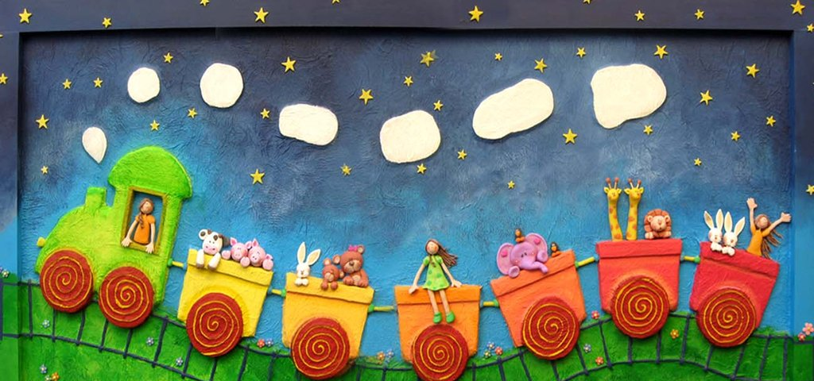
Let the good times roll!
Hop on the party train to experience several input based games that can be adapted to any language and level. Take your students on an engaging ride full of laughter and fun!

Slide 2
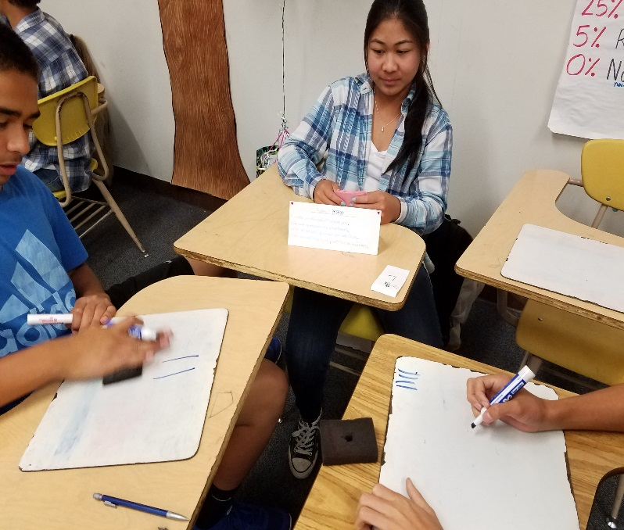
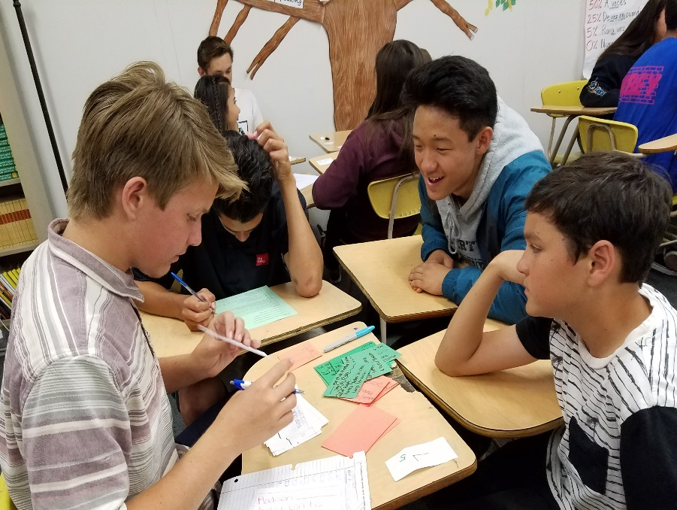
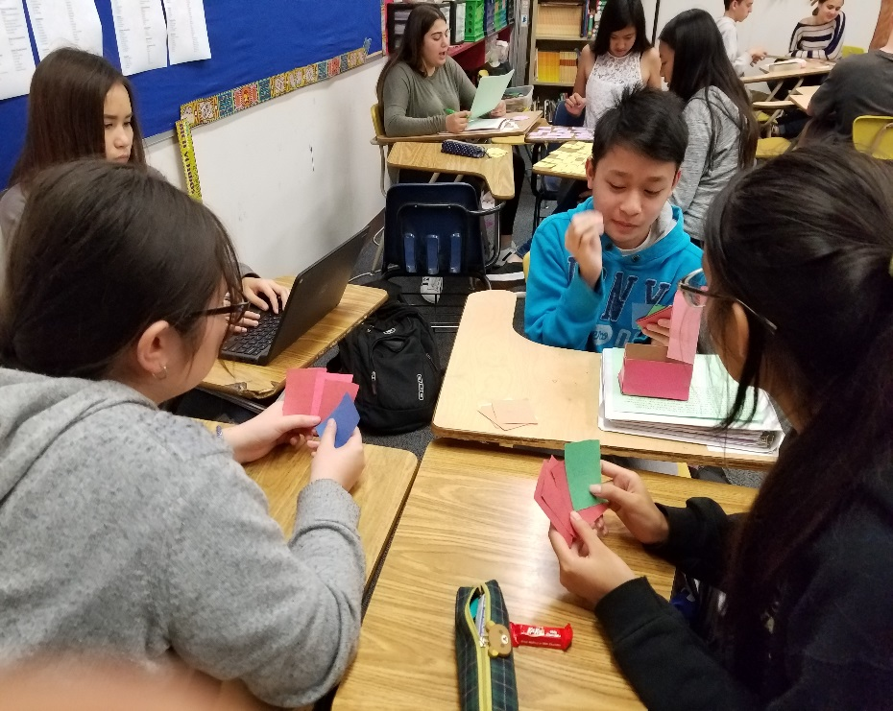
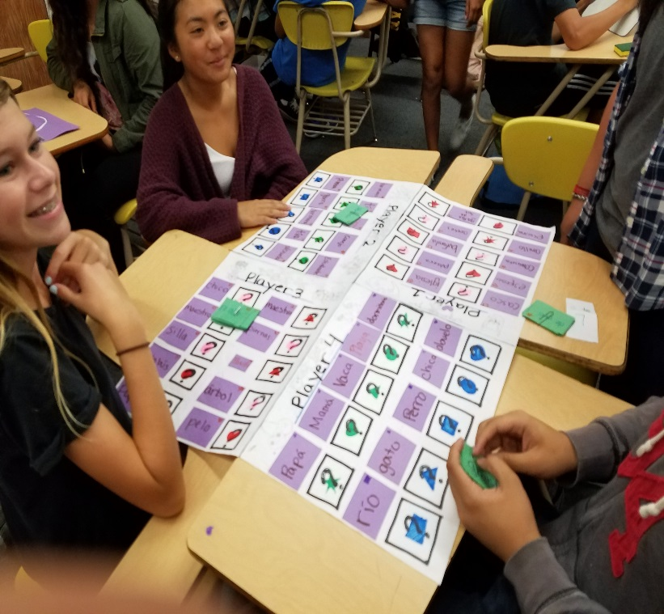
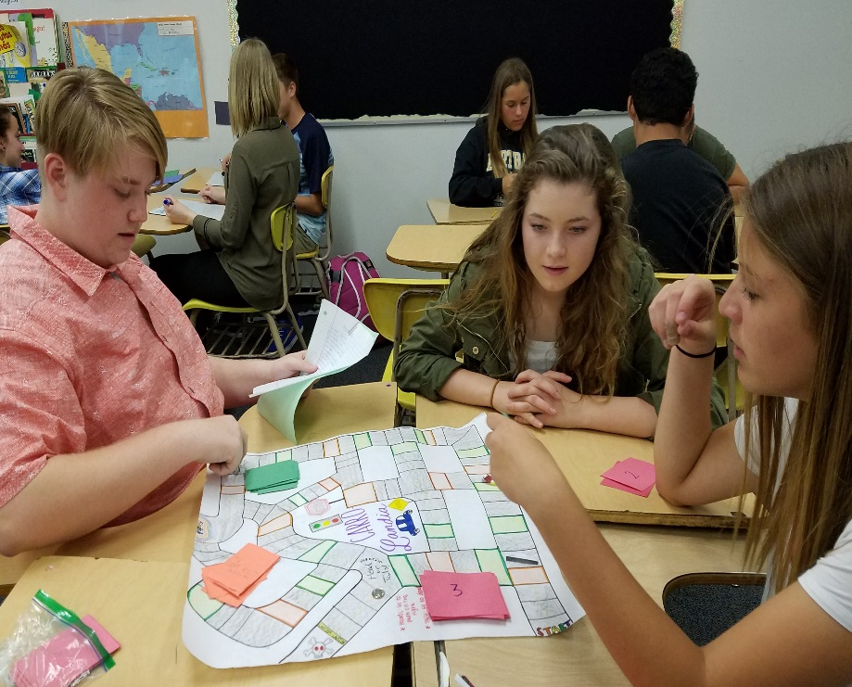
Notes:
Metzli

Slide 3
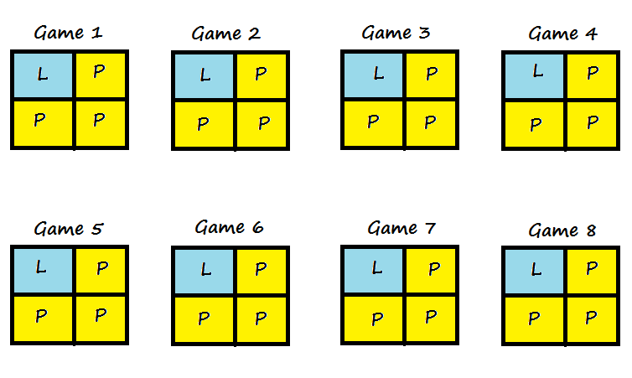
Notes:
Metzli

Slide 4
Headbands
How to play:
Everyone is wearing a headband.
The students take turns acting out or describing the card on their partner’s headband.
Each team has one minute to try to name as many cards on their headband based on the clues given.
The pair of students to name the most cards wins.
Skills addressed:
Interpretive listening, speaking
Levels:
Any level
Goal: Name the card on your headband

Slide 5
Spoons
How to play:
Students are dealt 4 cards each to start.
First student picks up a card from the center. If they choose to keep it, they must discard one, otherwise, they can discard that one. At this point it is the next student’s turn.
When a student reaches the goal they will reach for a spoon. (There should always be one less spoon than players playing). Once someone reaches for a spoon, the rest of the players must reach for a spoon too even if they don’t have their matches yet.
One student will end up without a spoon. This means they are out!
Skills addressed: Interpretive reading
Levels: Any level
Goal: Make 4 matches (picture, description, word in the target language, word in English)
Notes:
Ariene

Slide 6
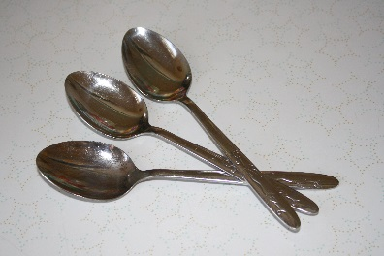
The leader picks up a card from the main pile, has the option to keep it or discard that one or a different one. The person on the left picks up the discarded card.
This player picks up the card discarded by the previous person and discards a card.
When the last player discards their card, they place it on the discard/trash pile.
You should have these three things in the middle
Main pile
Trash pile

Slide 7
El manazo
How to play:
One student describes or asks a question.
The rest of the students must find the card being described or the answer to the question by slapping it before the other students do.
Student with the most cards wins.
Skills addressed: Interpretive reading and listening
Levels: Any level
Goal: Identify vocabulary or the answer given after listening to a description or a question.
Notes:
Metzli

Slide 8
Chain Reaction
How to play:
Students in groups of 4 will need to work together to answer questions from a unit.
Each student will receive about 3 cards.
In each card, there is a answer and a question.
One student will read the question on the card and then the other students will find the answer to that question by looking at their cards.
Once they find that answer, they will read the question that is on that same card.
Group that finishes first, can get a prize or participation points.
Goal: Identify vocabulary or the answer given after listening to a description or a question.
Skills addressed: Interpretive reading and listening
Levels: Any level
Notes:
Ileana

Slide 9
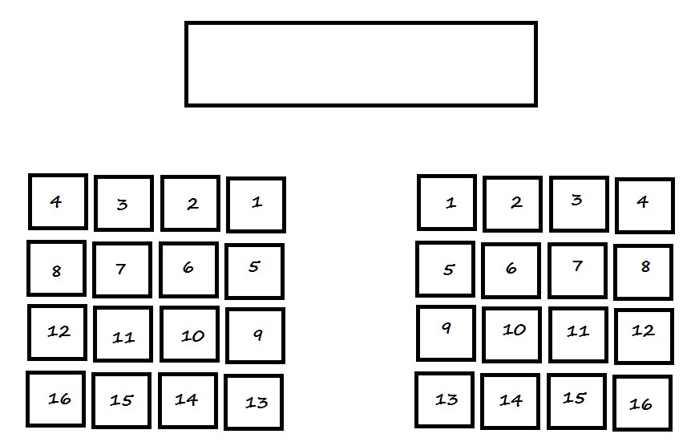
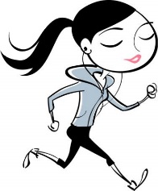
Runner up!
Hola
Notes:
Metzli

Slide 10
Share your own!

Slide 11
Notes:

