Slide 1
LET’S GET TALKING
Accountable Talk Strategies
Ariene Borutzki
Rene Murguia

Slide 2
TEAM BUILDING: A TASTE OF CARING AND MOTIVATING CLASSROOMS
With your group, share the following:
Red = a fun activity/vacation you participated in this summer
Orange = a favorite food
Pink = a personal goal
Yellow = a favorite tv show

Slide 3
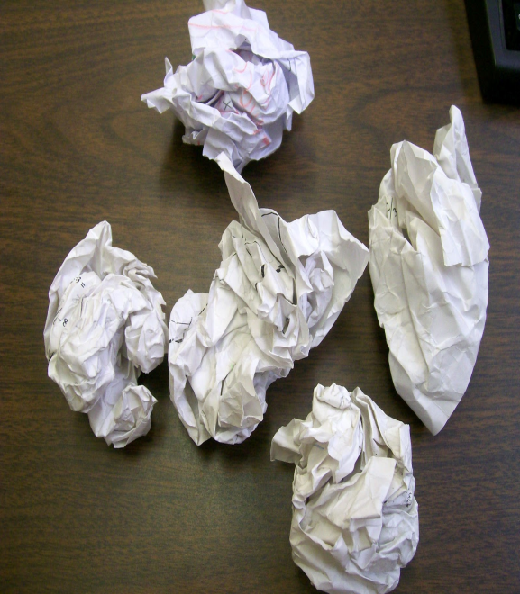
Snowball
This activity gives students an opportunity to share information anonymously in a low risk environment.
Read question (s) aloud to students. The questions can be getting to know you questions, or questions about topics that are being discussed in class.
Have students write their response on a post-it/piece of paper. They should not write their names on their paper.
Tell students to crumple their pieces of paper into “snowballs” and form a circle.
Yell, “snowball toss” and instruct students to toss their snowball towards the center of the circle.
Tell students to grab the closest snowball. Everyone should pick up one.
Share-out

Slide 4
What is something unique about you?

Slide 5
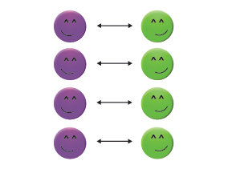
Lines of communication/Wagon Wheel
Provide students with a prompt/question.
Once students are done responding, divide students into A’s and B’s and have them form 2 lines.
Select one line to move and one to remain stationary.
Instruct students to share their response.
Once students are done sharing, movement will take place to allow students the opportunity to share with other partners.

Slide 6
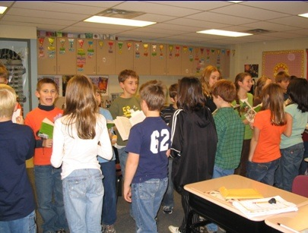
Who is someone you admire? Why?

Slide 7
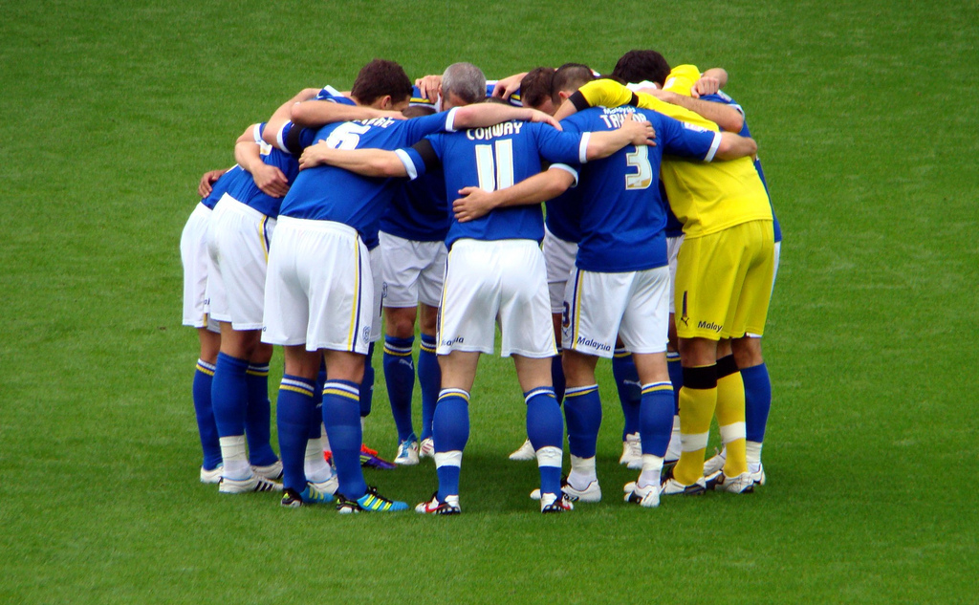
Team Huddle
Instruct all students to move around the room when they hear music playing, and then start the music. If the classroom is not conducive to this activity, consider going outside.
When you turn off the music, call out, “Huddle” and a number. For example, if you call out, “Huddle Four,” then students huddle in groups of four. Any extra players should form their own huddle.
Turn the music back on and continue calling out huddle groups of different numbers and giving them further instructions.

Slide 8
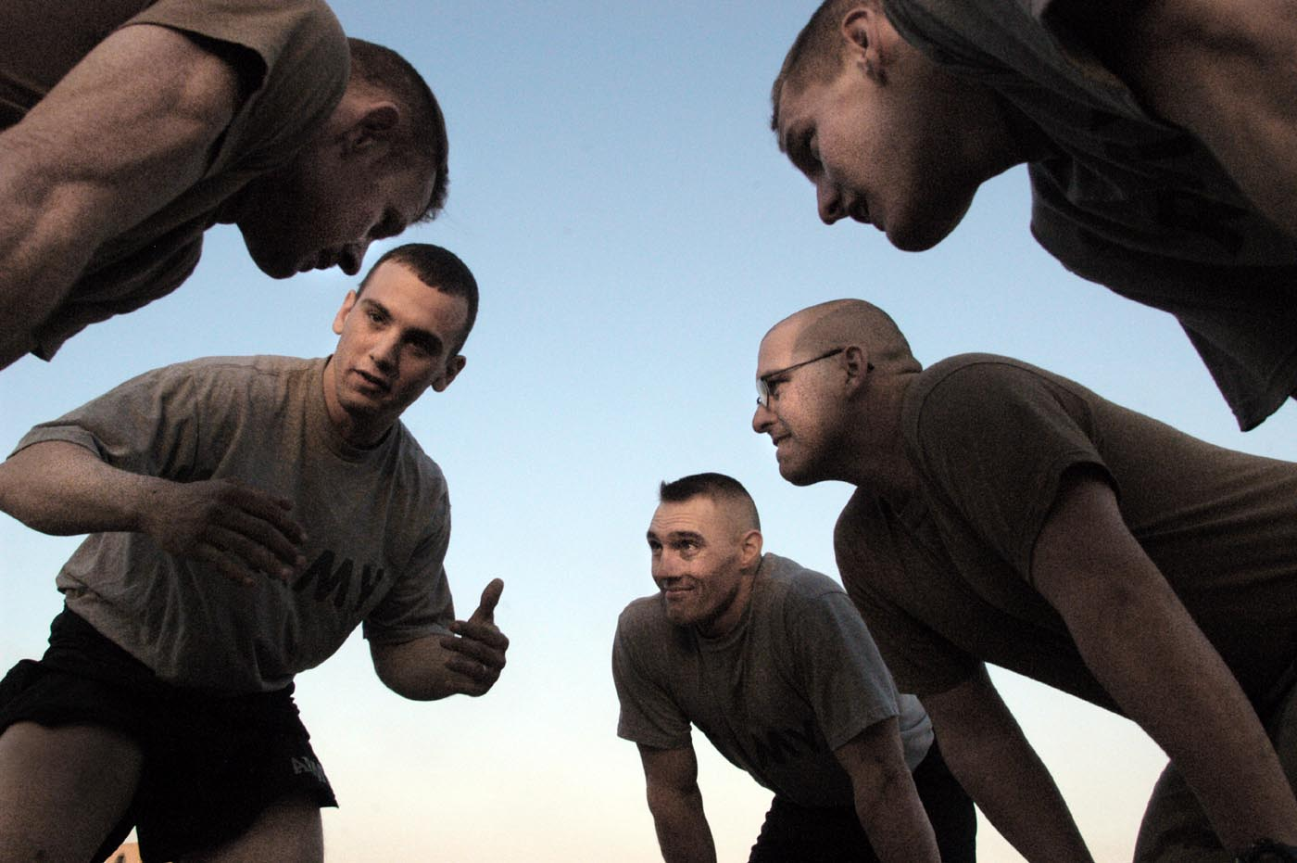
Let’s huddle
What is your favorite movie genre?
What is something you are afraid of?
What is your favorite vacation spot?

Slide 9
Give One, Get One
Have students answer a prompt on an activity worksheet.
After answering the prompt, divide students into A’s and B’s.
Have students stand and form A/B partnerships.
Once students have a partner, Partner A should share his/her response out loud. As partner A is speaking, Partner B will paraphrase in writing what Partner A is saying.
Once Partner B is done paraphrasing, the roles will be reversed and Partner B will speak while Partner A paraphrases.
Repeat the process to allow students the opportunity to share with multiple partners.

Slide 10
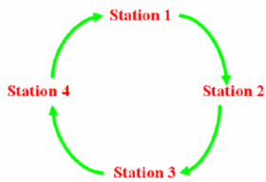
Gallery Walk
In a Gallery Walk, text or pictures are displayed around the classroom in stations accompanied by a prompt.
On a signal, groups pass from one station to another, discussing the prompt as a group and responding individually in writing on a post-it note.
Gallery Walk works best with open ended questions, concepts, issues, or debates that can be analyzed from several different perspectives.

Slide 11
Gallery Walk-What do you prefer?

Slide 12
Contact Information
Rene Murguia
rmurguia@ggusd.us
Ariene Borutzki
frenchie_stewart@hotmail.com

